Slide 1
RAC Database Creation

Slide 2
Objectives
After completing this lesson, you should be able to:
  Install the Enterprise Manager agent on each cluster node
  Create a cluster database
  Perform required tasks after database creation
Notes:
Oracle Database 11g: RAC Administration 3 - <number>

Slide 3
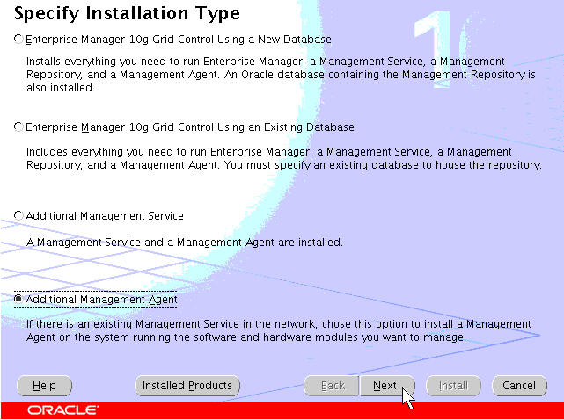
Management Agent Installation:
Specify Installation Type
$ cd /stage/EM
$ ./runInstaller
Notes:
Management Agent Installation: Specify Installation Type
There are two management tools available for your cluster database, Database Control and Grid Control. Both tools are based on Enterprise Manager, but Grid Control is the preferred tool for deploying and managing cluster databases in an enterprise setting. To use Grid Control, the Management Agent must be installed on each managed node in your cluster. To install the Management Agent, go to the Enterprise Manager Installation CD or a software staging area and start the Oracle Universal Installer. The Installation page provides several install types from which to choose from. Click the Additional Management Agent option button to install an agent only.

Slide 4
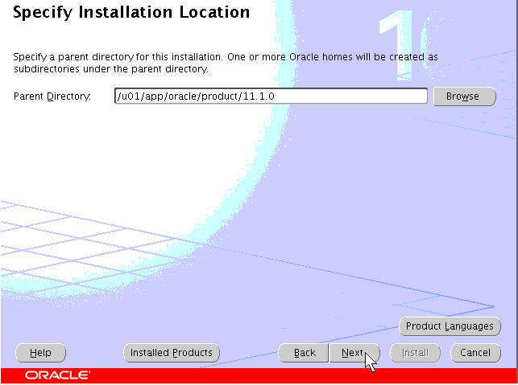
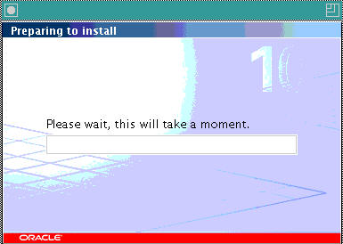
Specify Installation Location
Notes:
Specify Installation Location
The next page is the Specify Installation Location page. Because this cluster database installation uses an ORACLE_BASE set to /u01/app/oracle, the agent software should be installed in a subdirectory under ORACLE_BASE, with the other Oracle Homes. After starting the installation and specifying the installation location as shown in the example in the slide, the 11.1.0 subdirectory looks like this:
$ pwd
/u01/app/oracle/product/11.1.0
$ ls -l
total 20
drwxrwx--- 3 oracle oinstall 4096 Nov 12 07:59 agent
drwxr-x--- 54 oracle oinstall 4096 Nov 12 07:00 asm_1
drwxr-x--- 54 oracle oinstall 4096 Nov 12 07:16 db_1

Slide 5
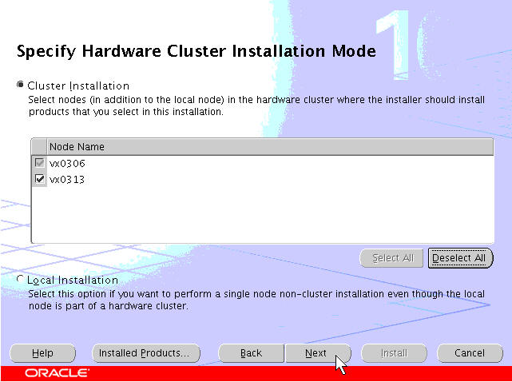
Specify Cluster Installation Mode
Notes:
Specify Cluster Installation Mode
The Specify Cluster Installation Mode screen is displayed next. Because you want to install the agent on all cluster nodes, click the Select All button to choose all the nodes of the cluster. Each node must be check marked before continuing. If all the nodes do not appear, you must stop the installation and troubleshoot your environment. If no problems are encountered, click the Next button to proceed.

Slide 6
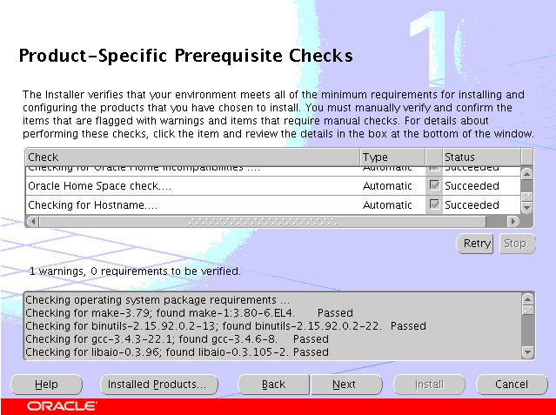
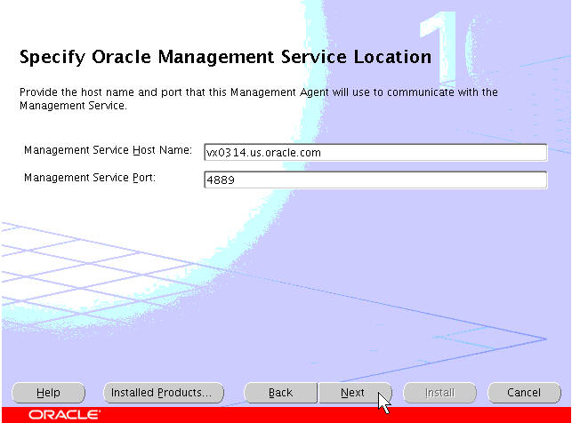
Prerequisite Check and OMS Location
Notes:
Prerequisite Check and OMS Location
The installer next checks the minimum requirements for the installation of the agent software. Any deficiencies are reported. You should take care of any issues identified by the installer before continuing with the installation. If the prerequisite check identifies no problems, click Next to continue.
The next screen requires you to identify the location of the Oracle management service. You must provide the host name and port number of an existing Grid Control console. In the example in the slide, a previously installed Grid Control console is specified on the host ex0043.us.oracle.com. The port number specified is the default port (4889) used by Grid Control. After you complete this step, click the Next button to continue.

Slide 7
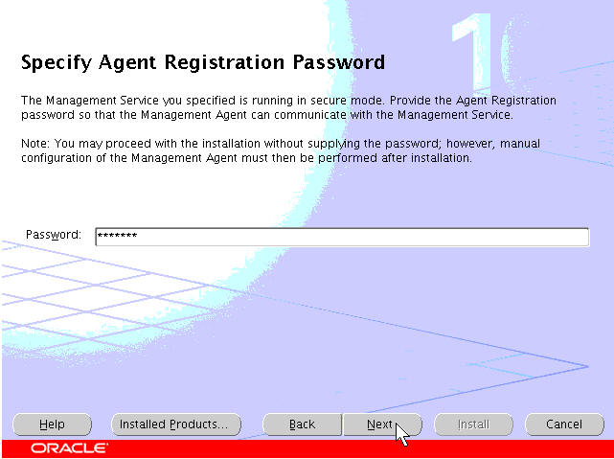
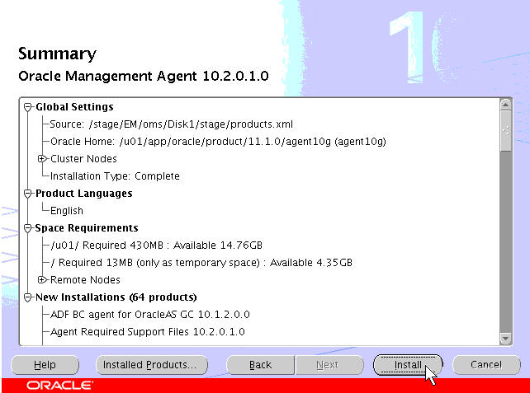
Agent Registration Password
Notes:
Agent Registration Password
On the Specify Agent Registration Password screen, you must provide the agent registration password. Do not specify an arbitrary password here, otherwise the agent registration will fail and the target nodes and their managed components will not be visible from the Grid Control server. In the example in the slide, you must provide the password for the Grid Control server located on vx0314.us.oracle.com. When this information is provided, click the Next button to continue.
The next screen is the Summary screen. Quickly review the information for accuracy and click the Next button to continue.

Slide 8
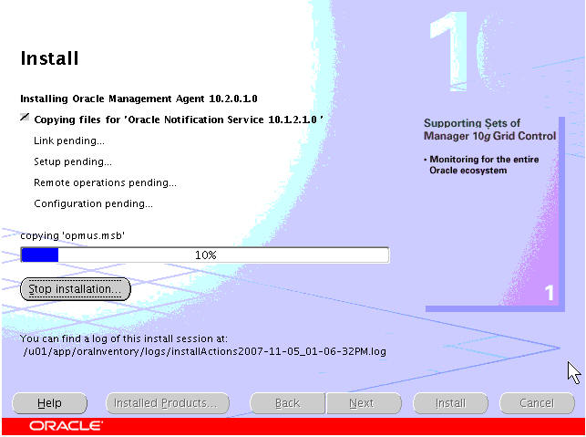
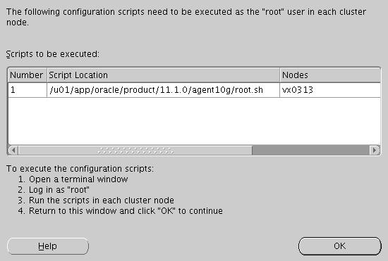
Management Agent Installation Finish
Notes:
Management Agent Installation Finish
During the course of the agent installation, you can monitor the progress of the install from the Install screen. When the installation is complete, you will be prompted to execute the root.sh scripts on all nodes where the agent was installed.

Slide 9
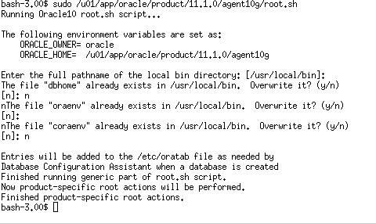
Executing the root.sh Script
Notes:
Executing the root.sh Script
When the script has been run on all nodes, close the Execute Configuration Scripts screen by clicking the Exit button and return to the installer. When the installer indicates that the agent has been installed, click the Exit button to quit the installer. You are now ready to create the cluster database.

Slide 10
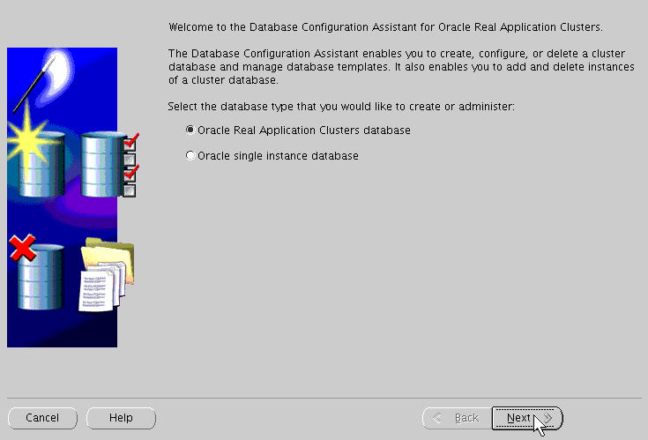
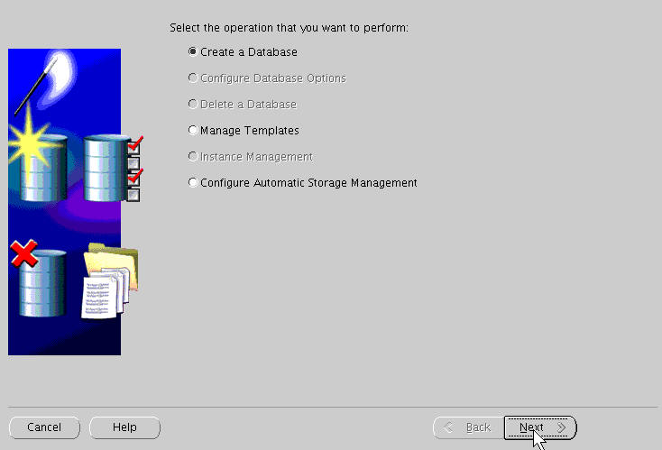
Creating the Cluster Database
$ cd /u01/app/oracle/product/11.1.0/db_1/bin
$ ./dbca
Notes:
Creating the Cluster Database
This database creation assumes that the database will use ASM for its shared storage. Change directory to $ORACLE_HOME/bin on the installing node and execute the DBCA as shown below:
$ cd /u01/app/oracle/product/11.1.0/db_1/bin
$ ./dbca
The Welcome screen appears first. You must select the type of database that you want to install. Click the Oracle Real Application Clusters database option button, and then click Next. The Operations screen appears. For a first-time installation, you have two choices only. The first option enables you to create a database and the other option enables you to manage database creation templates. Click the Create a Database option button, and then click Next to continue.

Slide 11
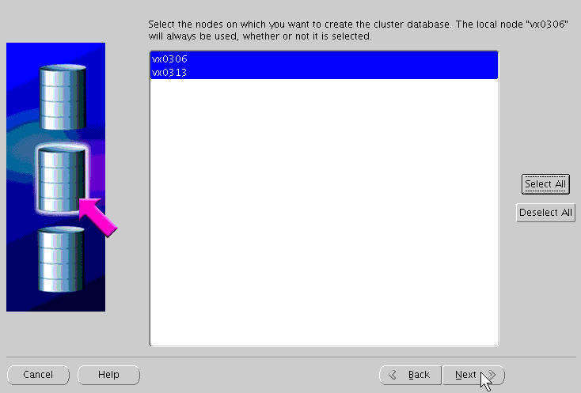
Node Selection
Notes:
Node Selection
The Node Selection screen is now displayed. Because you are creating a cluster database, choose all the nodes. Click the Select All button to choose all the nodes of the cluster. Each node must be highlighted before continuing. If all nodes do not appear, you must stop the installation and troubleshoot your environment. If no problems are encountered, click the Next button to proceed.

Slide 12
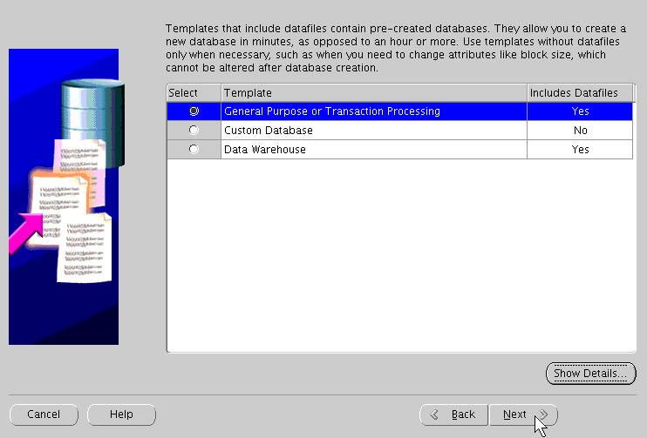
Select Database Type
Notes:
Select Database Type
The Database Templates screen appears. The DBCA tool provides several predefined database types to choose from, depending on your needs. The templates include:
General Purpose or Transaction Processing
Custom Database
Data Warehouse
In the example in the slide, the General Purpose or Transaction Processing option is chosen. Click the Next button to continue.

Slide 13
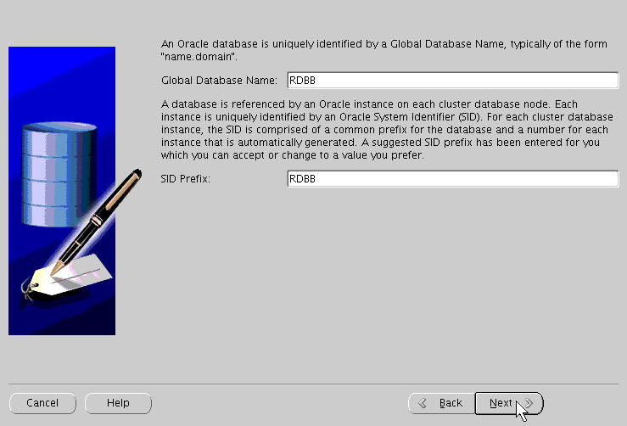
Database Identification
Notes:
Database Identification
In the Database Identification screen, you must enter the database name in the Global Database Name field. The name that you enter in this screen must be unique among all the global database names used in your environment. The global database name can be up to 30 characters in length and must begin with an alphabetical character.
A system identifier (SID) prefix is required, and the DBCA suggests a name based on your global database name. This prefix is used to generate unique SID names for the two instances that make up the cluster database. For example, if your prefix is RDBB, the DBCA creates two instances on node 1 and node 2 named RDBB1 and RDBB2, respectively. This example assumes that you have a two-node cluster. If you do not want to use the system-supplied prefix, enter a prefix of your choice. The SID prefix must begin with an alphabetical character and contain no more than 5 characters (on UNIX-based systems) or 61 characters (on Windows-based systems). Click the Next button to continue.

Slide 14
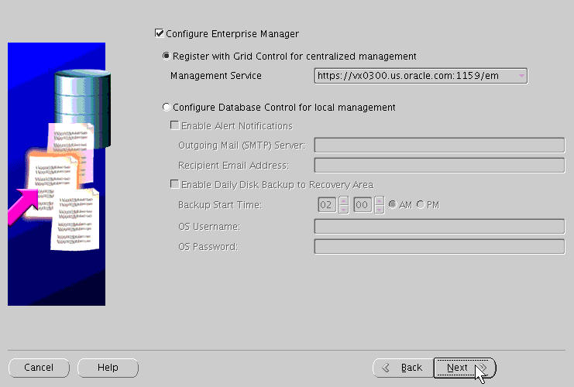
Cluster Database Management Method
Notes:
Cluster Database Management Method
The Management Options screen is displayed. For small cluster environments, you may choose to manage your cluster with Enterprise Manager Database Control. To do this, select the “Configure the Database with Enterprise Manager” check box. If you have Grid Control installed somewhere on your network, you can select the “Use Grid Control for Database Management” option. If you select Enterprise Manager with the Grid Control option and the DBCA discovers agents running on the local node, you can select the preferred agent from a list. Grid Control can simplify database management in large, enterprise deployments.
You can also configure Database Control to send email notifications when alerts occur. If you want to configure this, you must supply a Simple Mail Transfer Protocol (SMTP) or outgoing mail server and an email address. You can also enable daily backups here. You must supply a backup start time as well as operating system user credentials for this option.
If you want to use Grid Control to manage your database but have not yet installed and configured a Grid Control server, do not click either of the management methods. After making your choices, click the Next button to continue.

Slide 15
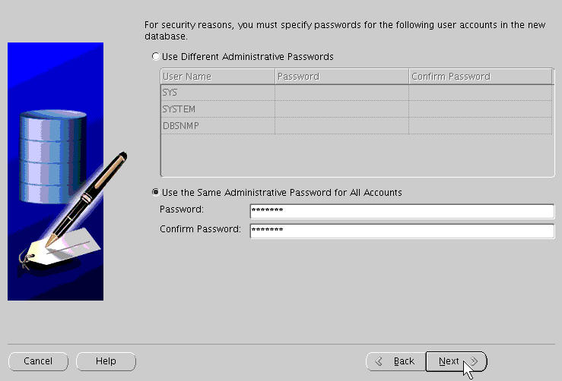
Passwords for Database Schema Owners
Notes:
Passwords for Database Schema Owners
The Database Credentials screen appears next. You must supply passwords for the user accounts created by the DBCA when configuring your database. You can use the same password for all of these privileged accounts by clicking the Use the Same Password for All Accounts option button. Enter your password in the Password field, and then enter it again in the Confirm Password field.
Alternatively, you may choose to set different passwords for the privileged users. To do this, click the Use Different Passwords option button, and then enter your password in the Password field, and then enter it again in the Confirm Password field. Repeat this for each user listed in the User Name column. Click the Next button to continue.

Slide 16
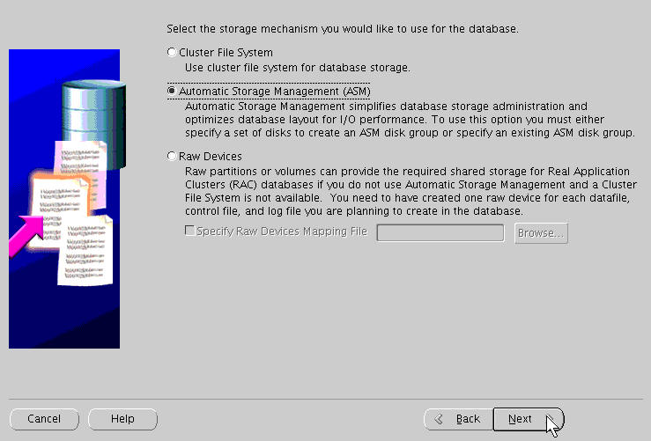
Storage Options for Database Files
Notes:
Storage Options for Database Files
On the Storage Options screen, you must select the storage medium where your shared database files are stored. Your three choices are:
Cluster File System
Automatic Storage Management (ASM)
Raw Devices
If you click the Cluster File System option button, you can click the Next button to continue.
If you click the Automatic Storage Management (ASM) option button, you can either use an existing ASM disk group or specify a new disk group to use. If there is no ASM instance on any of the cluster nodes, the DBCA displays the Create ASM Instance screen for you. If an ASM instance exists on the local node, the DBCA displays a dialog box prompting you to enter the password for the SYS user for ASM. To initiate the creation of the required ASM instance, enter the password for the SYS user of the ASM instance. After you enter the required information, click Next to create the ASM instance. After the instance is created, the DBCA proceeds to the ASM Disk Groups screen. If you have just created a new ASM instance, there is no disk group from which to select, so you must create a new one by clicking Create New to open the Create Disk Group screen.

Slide 17
Notes:
Storage Options for Database Files (continued)
After you are satisfied with the ASM disk groups available to you, select the one that you want to use for your database files, and click Next to proceed to the Database File Locations screen.
If you have configured raw devices, click the corresponding button. You must provide a fully qualified mapping file name if you did not previously set the DBCA_RAW_CONFIG environment variable to point to it. You can enter your response or click the Browse button to locate it. The file should follow the format of the example below:
system=/dev/vg_name/rdbname_system_raw_500m
sysaux=/dev/vg_name/rdbname_sysaux_raw_800m
...
redo2_2=/dev/vg_name/rdbname_redo2_2_raw_120m
control1=/dev/vg_name/rdbname_control1_raw_110m
control2=/dev/vg_name/rdbname_control2_raw_110m
spfile=/dev/vg_name/rdbname_spfile_raw_5m
pwdfile=/dev/vg_name/rdbname_pwdfile_raw_5m
where VG_NAME is the volume group (if configured) and rdbname is the database name. Because this example uses a preexisting ASM disk group, click the Automatic Storage Management button, and then the Next button to continue.

Slide 18
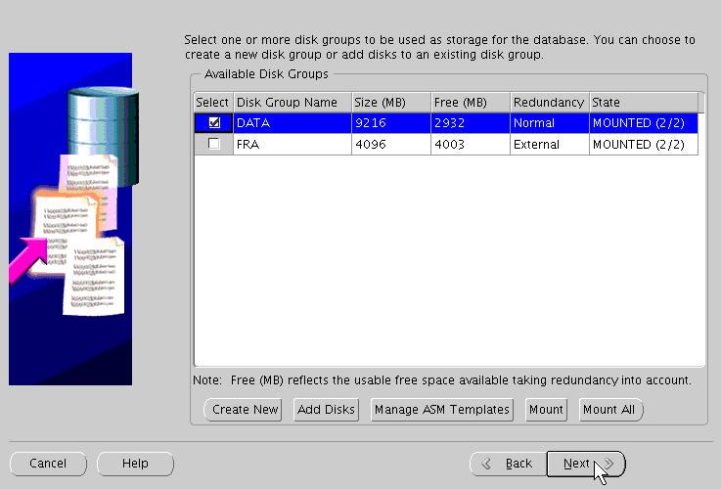
ASM Disk Groups
Notes:
ASM Disk Groups
On the ASM Disk Groups screen, you can choose an existing disk group to be used for your shared storage. To select a disk group, choose the Select check box corresponding to the disk group that you want to use. Alternatively, you can also create a new disk group to be used by your cluster database. When you are finished, click the Next button to continue.

Slide 19
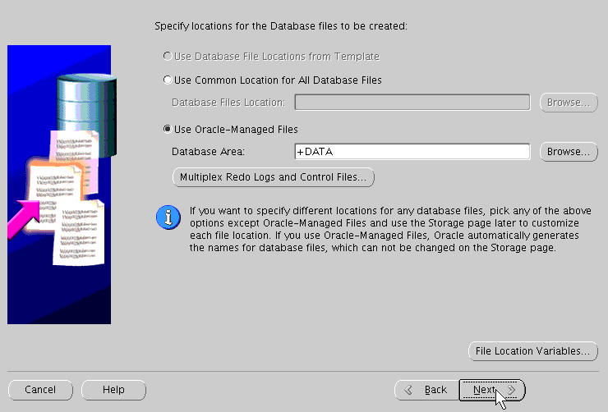
Database File Locations
Notes:
Database File Locations
On the Database File Locations screen, you must indicate where the database files are created. You can choose to use a standard template for file locations, one common location, or Oracle Managed Files (OMF). This cluster database uses Oracle-managed files. Therefore, select the Use Oracle-Managed Files option button, and enter the disk group name preceded with “+” in the Database Area field. Alternatively, you can click the Browse button to indicate the location where the database files are to be created. When you have made your choices, click the Next button to continue.

Slide 20
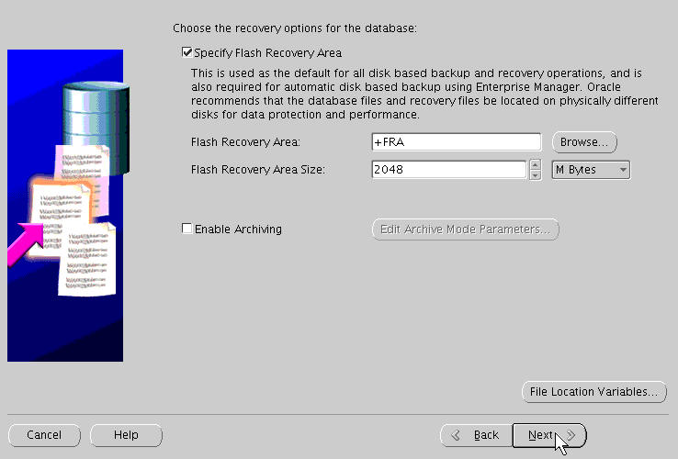
Recovery Configuration
Notes:
Recovery Configuration
On the Recovery Configuration screen, you can select redo log archiving by selecting Enable Archiving. If you are using ASM or cluster file system storages, you can also select the Flash Recovery Area size on the Recovery Configuration screen. The size of the area defaults to 2048 megabytes, but you can change this figure if it is not suitable for your requirements. If you are using ASM and a single disk group, the flash recovery area defaults to the ASM Disk Group. If more than one disk group has been created, you can specify it here. If you use a cluster file system, the flash recovery area defaults to $ORACLE_BASE/flash_recovery_area. You may also define your own variables for the file locations if you plan to use the Database Storage screen to define individual file locations.
When you have completed your entries, click Next, and the Database Content screen is displayed.

Slide 21
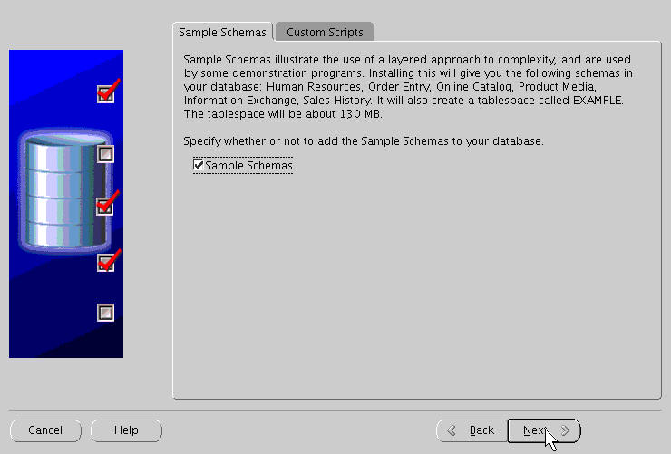
Database Content
Notes:
Database Content
On the Database Content screen, you can choose to install the Sample Schemas included with the database distribution. On the Custom Scripts tabbed page, you can choose to run your own scripts as part of the database creation process. When finished, click the Next button to continue to the next page.

Slide 22
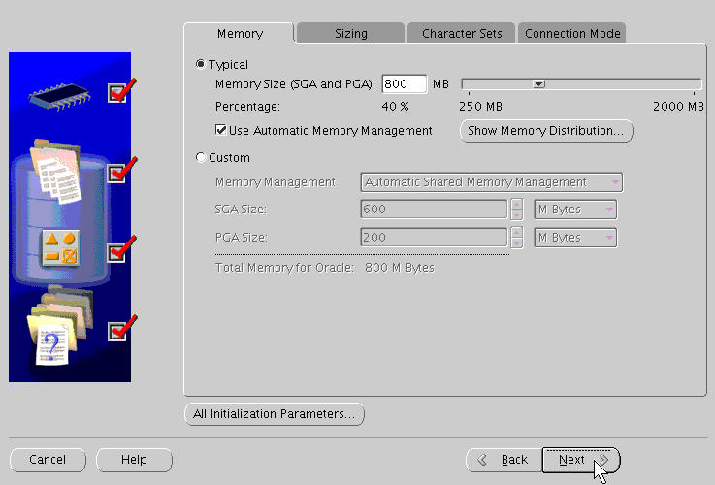
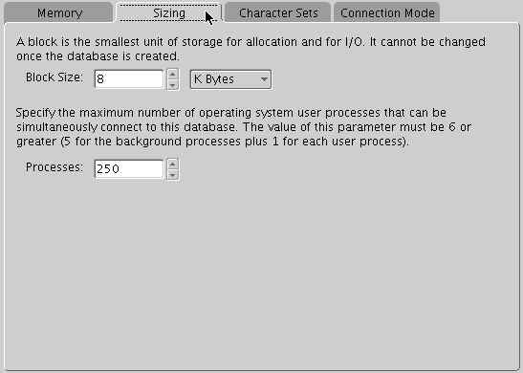
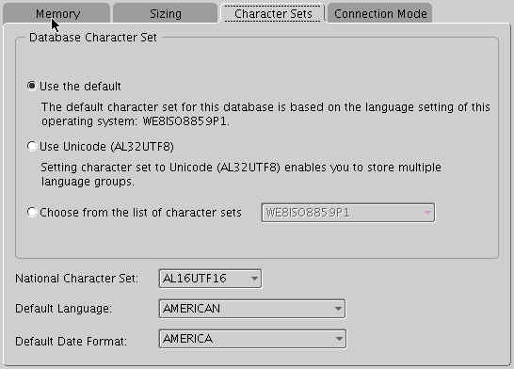
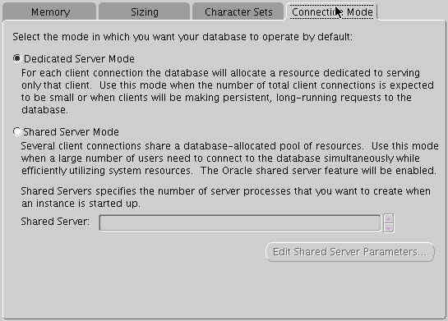
Initialization Parameters
Notes:
Initialization Parameters
On the Initialization Parameters screen, you can set important database parameters. The parameters are grouped on four tabs:
Memory
Sizing
Character Sets
Connection Mode
On the Memory tabbed page, you can set parameters that deal with memory allocation, including shared pool, buffer cache, Java pool, large pool, and PGA size. Automatic Memory Management is the preferred memory management method and can be selected here. On the Sizing tab, you can adjust the database block size. Note that the default is 8 KB. In addition, you can set the number of processes that can connect simultaneously to the database.
By clicking the Character Sets tab, you can change the database character set. You can also select the default language and the date format. On the Connection Mode tabbed page, you can choose the connection type that clients use to connect to the database. The default type is Dedicated Server Mode. If you want to use Oracle Shared Server, click the Shared Server Mode button. If you want to review the parameters that are not found in the four tabs, click the All Initialization Parameters button. Click the Use Automatic Memory Management button, and then click the Next button to continue.

Slide 23
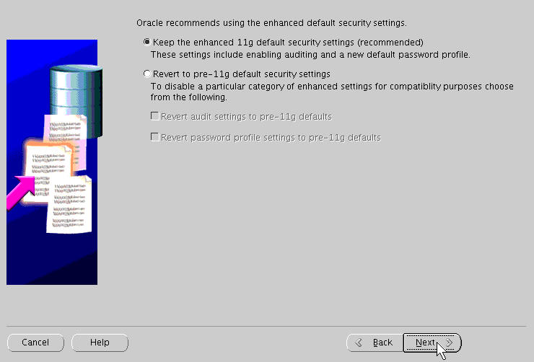
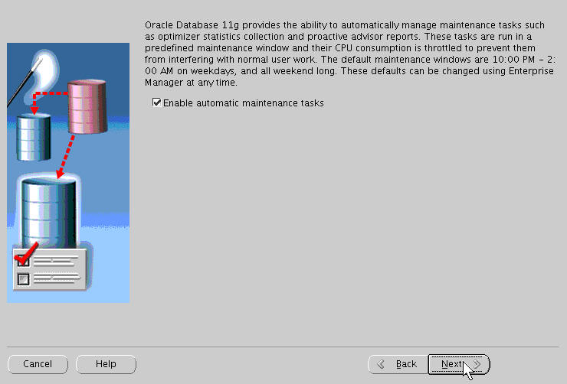
Security Settings and Maintenance Tasks
Notes:
Security Settings and Maintenance Tasks
On the Security Settings page you can choose between enhanced Oracle 11g security and the pre-11g model (which requires slightly less overhead). Make your choice here and click Next to continue. Click Enable automatic maintenance tasks to schedule metrics collection and advisor runs using predefined maintenance windows and resource consumption models.
Then click Next to continue.

Slide 24
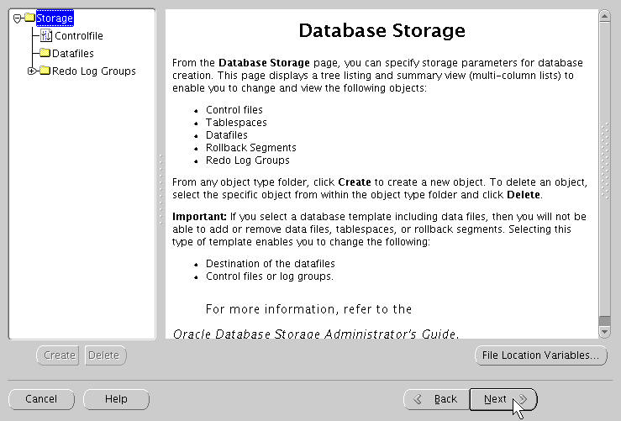
Database Storage Options
Notes:
Database Storage Options
The Database Storage screen provides full control over all aspects of database storage, including table spaces, data files, and log members. Size, location, and all aspects of extent management are under your control here.
When finished, click the Next button to continue to the next page.

Slide 25
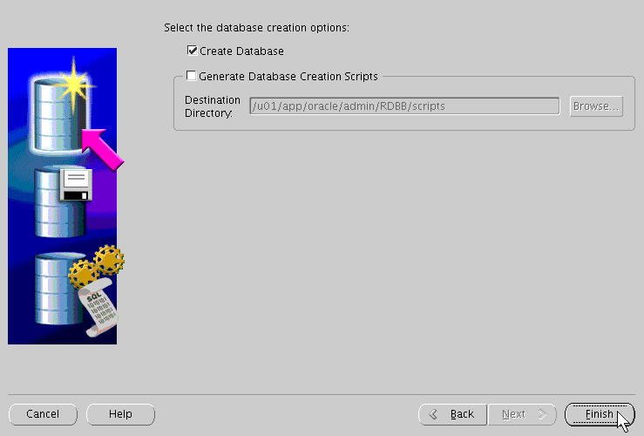
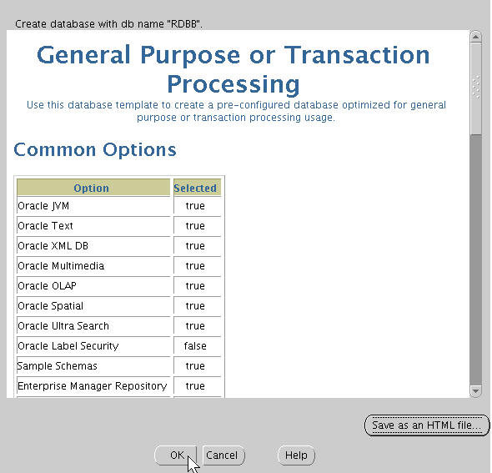
Create the Database
Notes:
Create the Database
The Creation Options screen appears next. You can choose to create the database, or save your DBCA session as a database creation script by clicking the corresponding button. Select the Create Database check box, and then click the Finish button. The DBCA displays the Summary screen, giving you the last chance to review all options, parameters, and so on that have been chosen for your database creation.
Review the summary data. When you are ready to proceed, close the Summary screen by clicking the OK button.

Slide 26
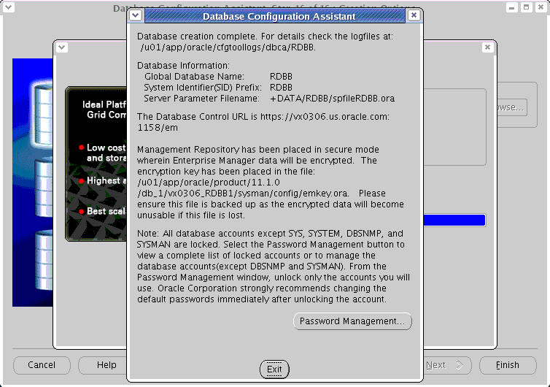
Monitor Progress
Notes:
Monitor Progress
The Progress Monitor screen appears next. In addition to informing you about how fast the database creation is taking place, it also informs you about the specific tasks being performed by the DBCA in real time. When the database creation progress reaches 100 percent, the DBCA displays a dialog box announcing the completion of the creation process. It also directs you to the installation log file location, parameter file location, and Enterprise Manager URL. By clicking the Password Management button, you can manage the database accounts created by the DBCA.

Slide 27
Postinstallation Tasks
  Verify the cluster database configuration.
  Back up the root.sh script.
  Back up the voting disk.
  Download and install the required patch updates.
$ srvctl config database -d racdb
vx0306 racdb1 /u01/app/.../db_1
vx0313 racdb2 /u01/app/.../db_1
$ cd $ORACLE_HOME
$ cp root.sh root.sh.bak
$ dd if=/dev/sdb6 of=/RACdb/OCR/backup/vdisk.bak
Notes:
Postinstallation Tasks
After the cluster database has been successfully created, run the following command to verify the Oracle Cluster Registry configuration in your newly installed RAC environment:
$ srvctl config database -d db_name
Server Control (SRVCTL) displays the name of the node and the instance for the node. The following example shows a node named vx0306 running an instance named racdb1. Execute the following command:
$ srvctl config database -d racdb
vx0306 racdb1 /u01/app/.../db_1
vx0313 racdb2 /u01/app/.../db_1
It is also recommended that you back up the root.sh script after you complete an installation. If you install other products in the same Oracle Home directory, the OUI updates the contents of the existing root.sh script during the installation. If you require information contained in the original root.sh script, you can recover it from the root.sh file copy.
After your Oracle Database 11g RAC installation is complete and after you are sure that your system is functioning properly, make a backup of the contents of the voting disk by using the dd utility.

Slide 28
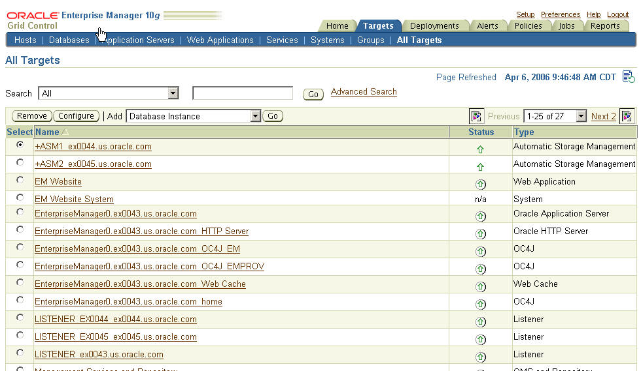
Check Managed Targets
http://vx0314.us.oracle.com:4889/em
Notes:
Check Managed Targets
Another post-installation task you should perform if you are using Grid Control is to check that all the managed nodes and their managed resources are properly registered and available. Open a browser and enter the address for your Grid Control console. Click the Targets tab to verify that all the targets appear here.

Slide 29

Single Instance to RAC Conversion
  Single-instance databases can be converted to RAC using:
    DBCA
    Enterprise Manager
    RCONFIG utility
  DBCA automates most of the conversion tasks.
  Before conversion, ensure that:
    Your hardware and operating system are supported
    Your cluster nodes have access to shared storage
Single-instance database
RAC database
Notes:
Single Instance to RAC Conversion
You can use the Database Configuration Assistant (DBCA) to convert from single-instance Oracle databases to RAC. The DBCA automates the configuration of the control file attributes, creates the undo tablespaces and the redo logs, and makes the initialization parameter file entries for cluster-enabled environments. It also configures Oracle Net Services, Oracle Clusterware resources, and the configuration for RAC database management for use by Oracle Enterprise Manager or the SRVCTL utility.
Before you use the DBCA to convert a single-instance database to a RAC database, ensure that your system meets the following conditions:
It is a supported hardware and operating system software configuration.
It has shared storage: Either Oracle Cluster File System or ASM is available and accessible from all nodes.
Your applications have no design characteristics that preclude their use with cluster database processing.
If your platform supports a cluster file system, then you can use it for RAC. You can also convert to RAC and use a nonshared file system. In either case, it is recommended that you use the Oracle Universal Installer (OUI) to perform an Oracle Database 10g installation that sets up the Oracle Home and inventory in an identical location on each of the selected nodes in your cluster.

Slide 30
Single-Instance Conversion Using the DBCA
Conversion steps for a single-instance database on
nonclustered hardware:
  Back up the original single-instance database.
  Perform the preinstallation steps.
  Set up and validate the cluster.
  Copy the preconfigured database image.
  Install the Oracle Database 10g software with Real Application Clusters.
Notes:
Single-Instance Conversion Using DBCA
To convert from a single-instance Oracle database that is on a noncluster computer to a RAC database, perform the steps outlined below, and in the order shown:
1. Back up the original single-instance database.
2. Perform the preinstallation steps.
3. Set up the cluster.
4. Validate the cluster.
5. Copy the preconfigured database image.
6. Install the Oracle Database 10g software with Real Application Clusters.

Slide 31
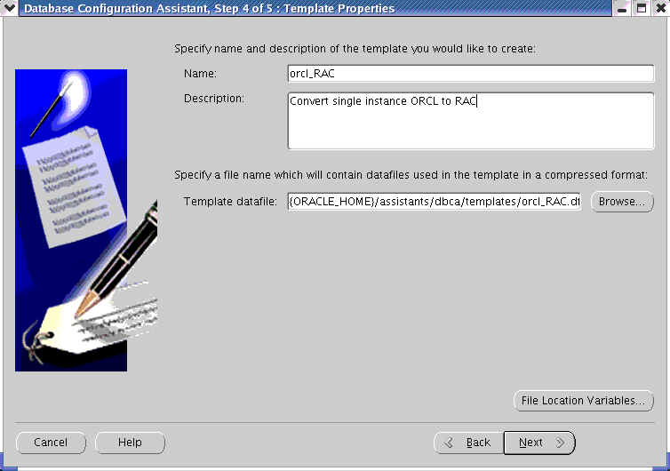
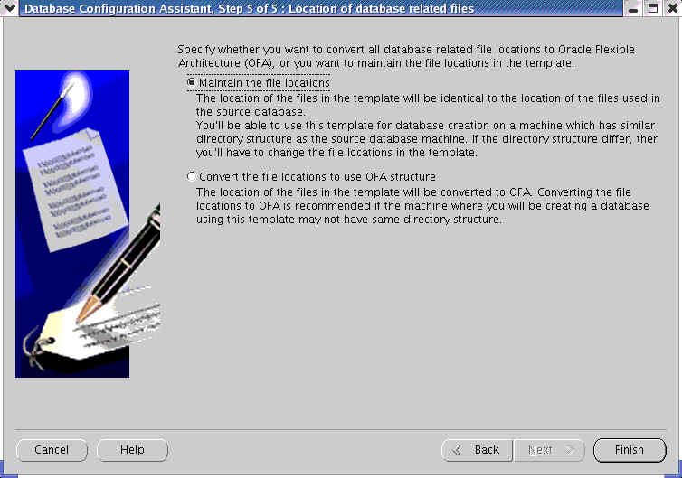
Conversion Steps
  Back up the original single-instance database.
Notes:
Conversion Steps
1. Back up the original single-instance database.
Use the DBCA to create a preconfigured image of your single-instance database by using the following procedure:
1. Navigate to the bin directory in $ORACLE_HOME, and start the DBCA.
2. On the Welcome screen, click Next.
3. On the Operations screen, select Manage Templates, and click Next.
4. On the Template Management screen, select “Create a database” template and “From an existing database (structure as well as data),” and click Next. On the Source Database screen, enter the database name in the Database instance field, and click Next.
5. On the Template Properties screen, enter a template name in the Name field. By default, the template files are generated in the ORACLE_HOME/assistants/dbca/templates directory. Enter a description of the file in the Description field, and change the template file location in the Template data file field if you want. When finished, click Next.
6. On the Location of Database Related Files screen, select “Maintain the file locations,” so that you can restore the database to the current directory structure, and click Finish. The DBCA generates two files: a database structure file (template_name.dbc) and a database preconfigured image file (template_name.dfb).

Slide 32
Conversion Steps
  Perform the preinstallation steps.
    Tasks include kernel parameter configuration, hardware setup, network configuration, and shared storage setup.
  Set up and validate the cluster.
    Create a cluster with the required number of nodes according to your hardware vendor’s documentation.
    Validate cluster components before installation.
    Install Oracle Clusterware.
    Validate the completed cluster installation using cluvfy.
  Copy the preconfigured database image.
    Copy the preconfigured database image including:
      The database structure *.dbc file
      The preconfigured database image *.dfb file
Notes:
Conversion Steps (continued)
2. Perform the preinstallation steps.
Several tasks must be completed before Oracle Clusterware and Oracle Database 10g software can be installed. Some of these tasks are common to all Oracle database installations and should be familiar to you. Others are specific to Oracle RAC 10g. You can review these tasks by referring to the lesson titled “Oracle Clusterware Installation and Configuration.”
3. Set up and validate the cluster.
Form a cluster with the required number of nodes according to your hardware vendor’s documentation. When you have configured all of the nodes in your cluster, validate cluster components by using the cluvfy utility, and then install Oracle Clusterware. When the clusterware is installed, validate the completed cluster installation and configuration using the Cluster Verification Utility, cluvfy.
4. Copy the preconfigured database image.
This includes copying the database structure *.dbc file and the database preconfigured image *.dfb file that the DBCA created in step one (Back Up the Original Single-Instance Database) to a temporary location on the node in the cluster from which you plan to run the DBCA.

Slide 33
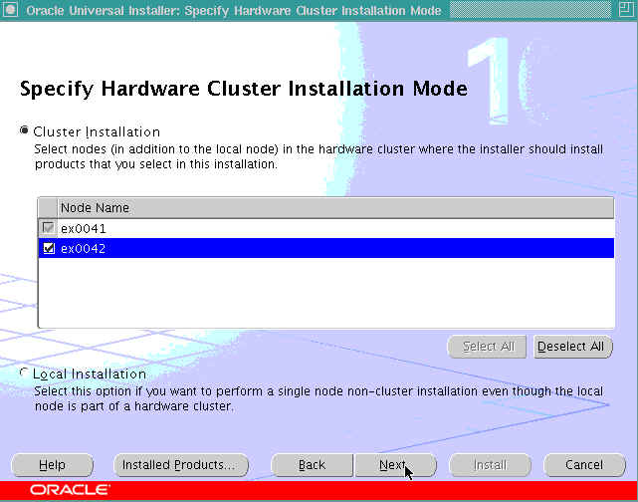
Conversion Steps
  Install the Oracle Database 11g software with RAC.
Notes:
Conversion Steps (continued)
5. Install the Oracle Database 10g software with RAC.
1. Run the OUI to perform an Oracle database installation with RAC. Select Cluster Installation Mode on the Specify Hardware Cluster Installation screen of the OUI, and select the nodes to include in your RAC database.
2. On the OUI Database Configuration Types screen, select “Advanced install.” After installing the software, the OUI runs postinstallation tools such as NETCA, DBCA, and so on.
3. On the DBCA Template Selection screen, use the template that you copied to a temporary location in the “Copy the Preconfigured Database Image” step. Use the browse option to select the template location.
4. If you selected raw storage on the OUI Storage Options screen, then on the DBCA File Locations tab of the Initialization Parameters screen, replace the data files, control files, and log files, and so on, with the corresponding raw device files if you did not set the DBCA_RAW_CONFIG environment variable. You must also replace default database files with raw devices on the Storage page.
5. After creating the RAC database, the DBCA displays the Password Management screen on which you must change the passwords for database privileged users who have SYSDBA and SYSOPER roles. When the DBCA exits, the conversion process is complete.

Slide 34
Single-Instance Conversion Using rconfig
  Edit the ConvertToRAC.xml file located in the $ORACLE_HOME/assistants/rconfig/sampleXMLs directory.
  Modify the parameters in the ConvertToRAC.xml file as required for your system.
  Save the file under a different name.
$ cd $ORACLE_HOME/assistants/rconfig/sampleXMLs
$ vi ConvertToRAC.xml
$ rconfig my_rac_conversion.xml
Notes:
Single-Instance Conversion Using rconfig
You can use the command-line utility rconfig to convert a single-instance database to RAC. To use this feature, complete the following steps:
1. Go to the $ORACLE_HOME/assistants/rconfig/sampleXMLs directory as the oracle user, and open the ConvertToRAC.xml file using a text editor, such as vi.
2. Review the ConvertToRAC.xml file, and modify the parameters as required for your system. The XML sample file contains comment lines that provide instructions for how to configure the file.
When you have completed making changes, save the file with the syntax filename.xml. Make a note of the name you select.
3. Assuming that you save your XML file as my_rac_conversion.xml, navigate to the $ORACLE_HOME/bin directory, and use the following syntax to run the rconfig command:
$ rconfig my_rac_conversion.xml
Note: The Convert verify option in the ConvertToRAC.xml file has three options:
Convert verify="YES": rconfig performs checks to ensure that the prerequisites for single-instance to RAC conversion have been met before it starts conversion.

Slide 35
Notes:
Single-Instance Conversion Using rconfig (continued)
Convert verify="NO": rconfig does not perform prerequisite checks; it starts conversion.
Convert verify="ONLY": rconfig performs only prerequisite checks; it does not start conversion after completing prerequisite checks.

Slide 36
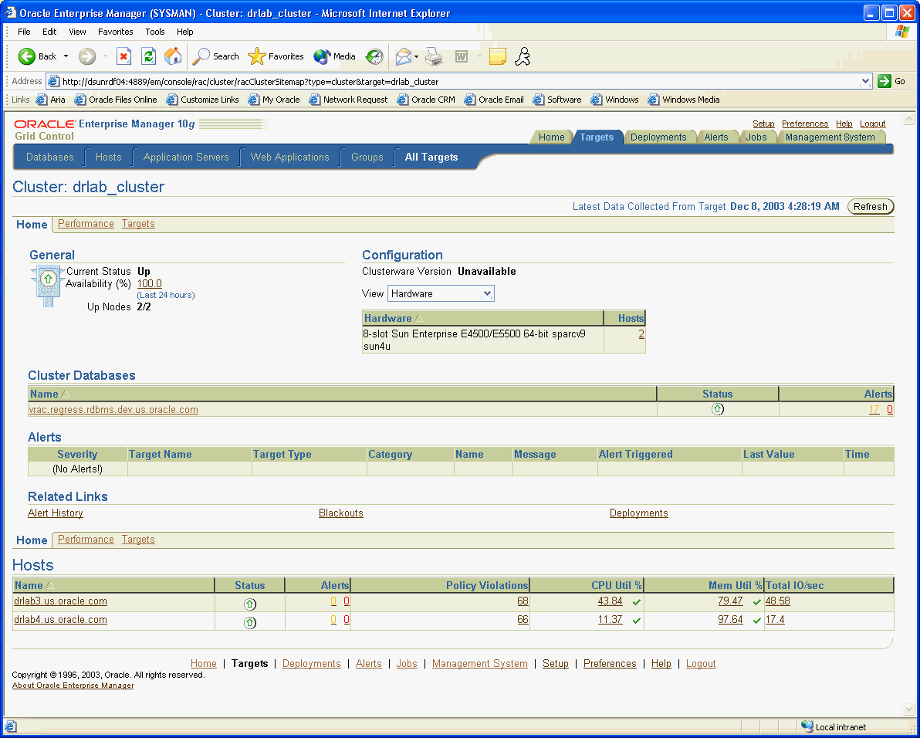
Single-Instance Conversion Using Grid Control
Notes:
Single-Instance Conversion Using Grid Control
In addition to using the DBCA and rconfig for single-instance conversion, you can also use Enterprise Manager Grid Control to convert a single-instance database to RAC. To use this feature of Grid Control, complete the following steps:
1. Log in to Grid Control. From the Grid Control Home page, click the Targets tab.
2. On the Targets page, click the Databases secondary tab, and click the link in the Names column of the database that you want to convert to RAC.
3. On the Database Instance Home page, click the Administration secondary tab.
4. On the Administration page, in the Database Administration Change Database section, click Convert to Cluster Database.
5. Log in as the database user SYS with SYSDBA privileges to the database you want to convert, and click Next.
6. On the Convert to Cluster Database: Cluster Credentials page, provide a username and password for the oracle user and password of the target database that you want to convert. If the target database is using ASM, then provide the ASM SYS user and password and click Next.
7. On the Hosts page, select the host nodes in the cluster that you want to be cluster members in the RAC database installed. When you have completed your selection, click Next.

Slide 37
Notes:
Single-Instance Conversion Using Grid Control (continued)
8. On the Convert to Database: Options page, select whether you want to use the existing listener and port number or specify a new listener and port number for the cluster. Also, provide a prefix for the cluster database instances. When you have finished entering information, click Next.
9. On the Convert to Cluster Database: Shared Storage page, either select the option to use your existing shared storage area, or select the option to have your database files copied to a new shared storage location. Also, decide whether you want to use your existing flash recovery area, or if you want to copy your flash recovery files to a new area using Oracle Managed Files. When you have finished entering information, click Next.
10. On the Convert to Cluster Database: Review page, review the options you have selected. Click Submit Job to proceed with the conversion.
11. On the Confirmation page, click View Job to check the status of the conversion.

Slide 38
Summary
In this lesson, you should have learned how to:
  Install the Oracle Enterprise Manager agent
  Create a cluster database
  Perform required tasks after database creation
Notes:
Oracle Database 11g: RAC Administration 3 - <number>

Slide 39
Practice 3: Overview
This practice covers the following topics:
  Installing the Enterprise Manager agent on each cluster node
  Confirming that the services needed by the database creation process are running
  Creating a cluster database
Notes:
Oracle Database 11g: RAC Administration 3 - <number>

